Slide 1

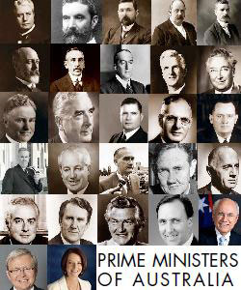

Slide 2
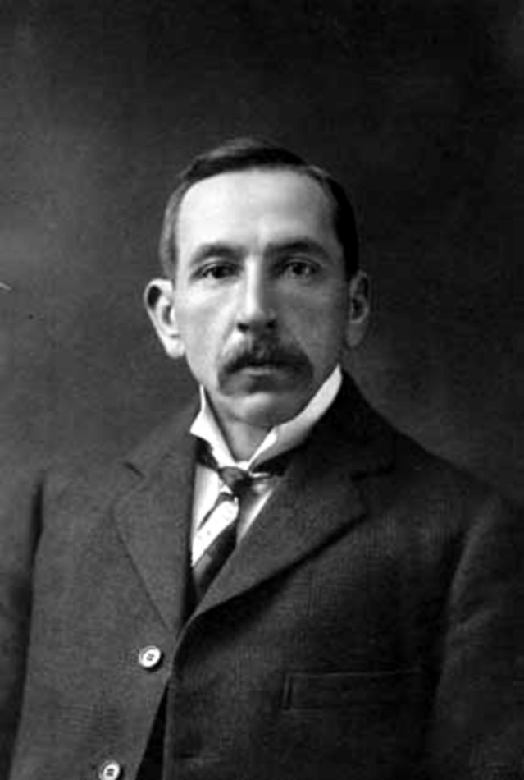
What Australian Prime Minister Am I?
I was instrumental in the international recognition of Australia as a separate nation.
I was initially the leader of the Labor Party.
I hold the record for time served in Australia’s house of representatives.
I led (as Prime Minister) Australia during World War 1.
I was responsible for campaigning for conscription during WW1. This ultimately split the Labor Party.

